Slide 1
UI PATTERN
Human Computer Interaction
By: Nguyễn Công Hoan

Slide 2
Agenda
Overview
Mobile UI Patterns
Web UI Patterns
How to apply?

Slide 3
Design Problem
Notes:
Điện thoại android với số lượng ng dung càng ngày càng tăng, vượt và bỏ xa các đối thủ khác, vì vậy, các ứng dụng trên android cũng theo đó mà phát triển. Không ít những người lập trình viên đều chọn hướng app android để phát triển năng lực.
Đặt ra câu hỏi: tại sao android lại có nhiều người sử dụng: đứng trên lập trường ng sử dụng, mình thấy android có giá thành tương đối, phù hợp vs nhìu người, đồng thời giao diện dễ sử dụng.

Slide 4

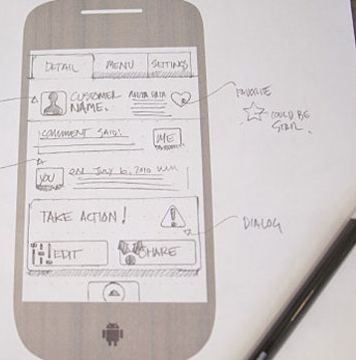
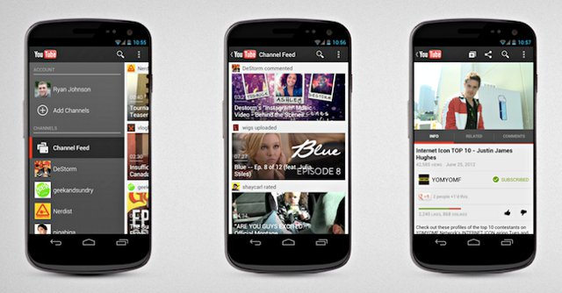

Design Proglem

Slide 5

Design Everything From Zero
Time losing
Developers A
Design
His Button
Developers B
Design
His Button
Developers C
Design
His Button
Developers …
Design
His Button

Slide 6
Solution
Developers Volunteer
Research
Design user control
Packing to lib
Developers A
Developers A UI
Tiết kiệm thời gian
Developers B
Developers B UI
Custom control in lib
Developers C
Developers C UI
Developers …
Developers … UI

Slide 7
UI Design Pattern
Object-oriented Methodology
“Design patterns are descriptions of communicating objects and classes that are customized to solve a general design problem in a particular context” (Erich Gamma et al. 1995)
Generally, a design pattern is a description of the repeatable problem and its solution
UI design patterns are descriptions of common UI design problems and their solutions

Slide 8
Mobile UI Patterns
Navigation
Forms
Search
Feedback

Slide 9
Mobile Navigation
Springboard
Tab menu
List menu
Gallery
Metaphor

Slide 10
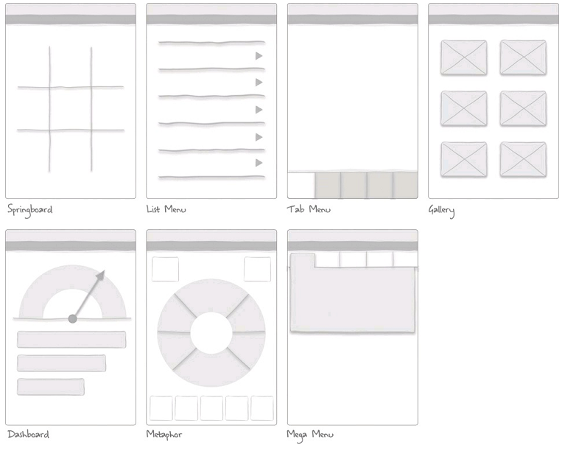
Primary Navigation Patterns

Slide 11
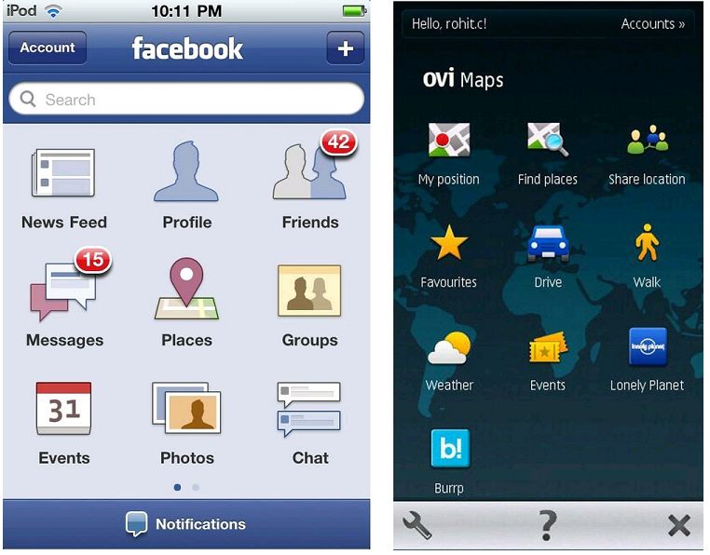
Springboard

Slide 12
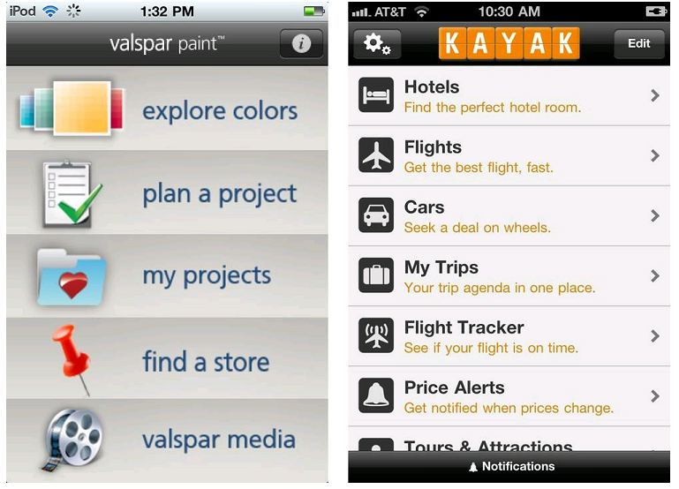
List Menu

Slide 13
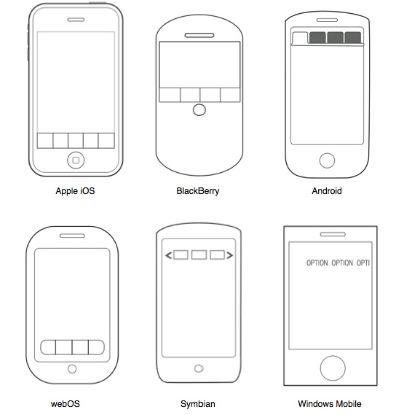
Tabs

Slide 14
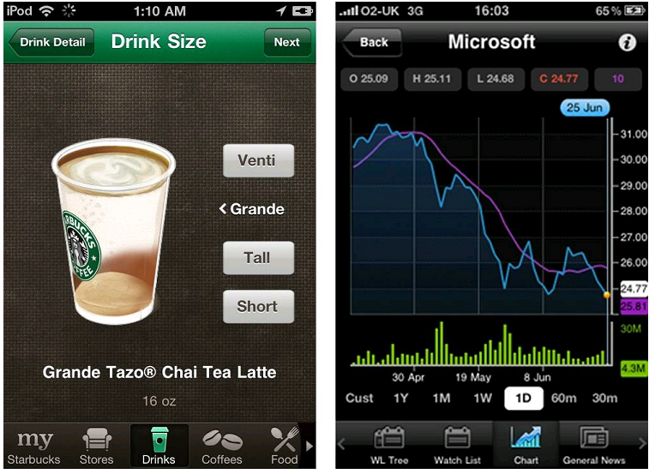
Tabs (cont.)

Slide 15
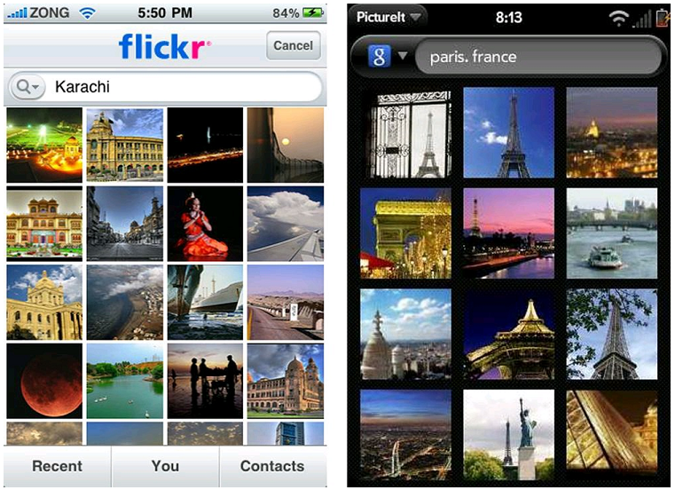
Gallery

Slide 16
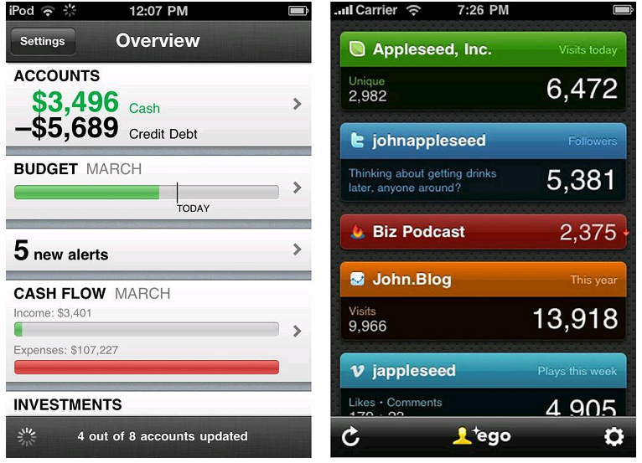
Dashboard

Slide 17
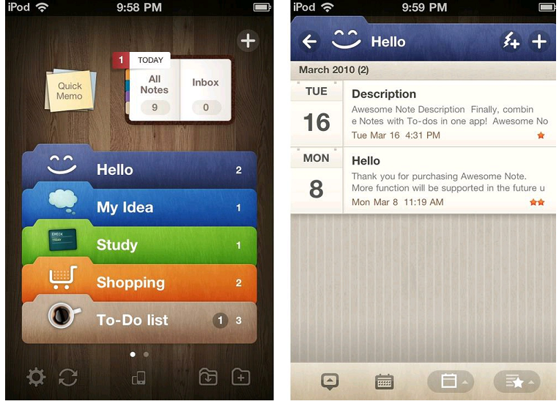
Metaphor

Slide 18
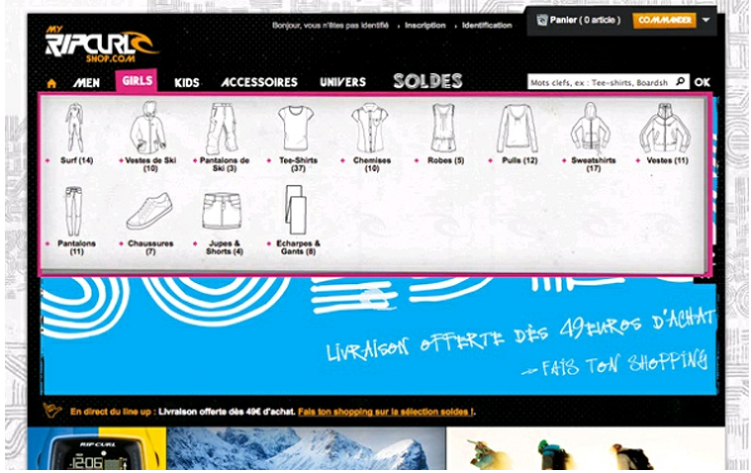
Mega Menu

Slide 19
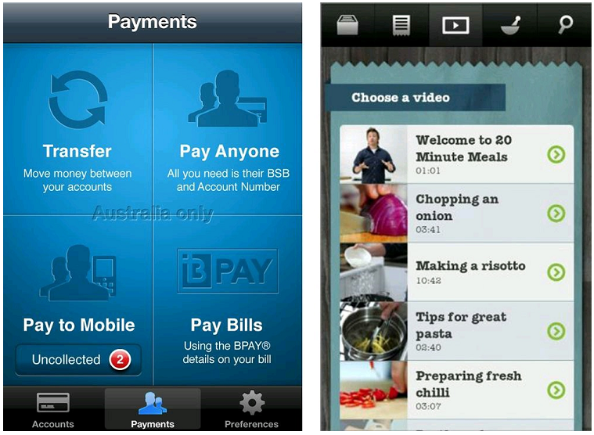
Secondary Navigation
(Left) Primary, tabs; secondary, springboard. (Right) Primary, tabs; secondary, list.

Slide 20
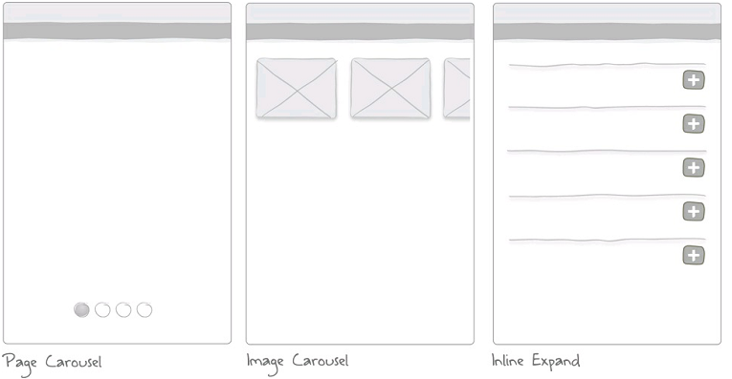
Secondary Navigation

Slide 21
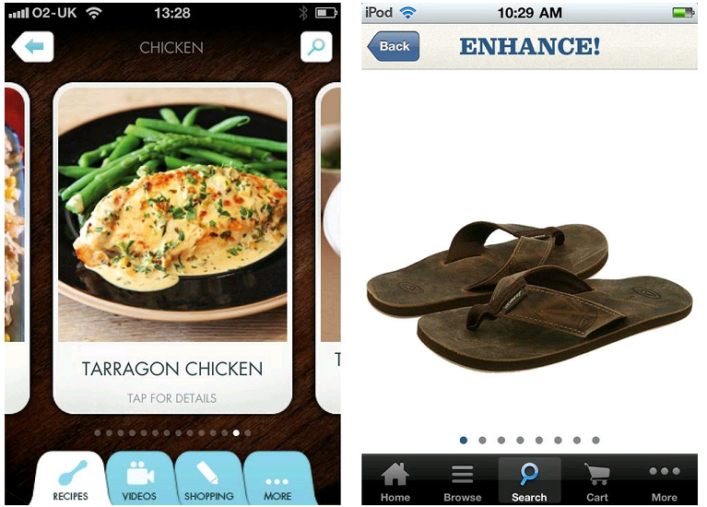
Page Carousel

Slide 22
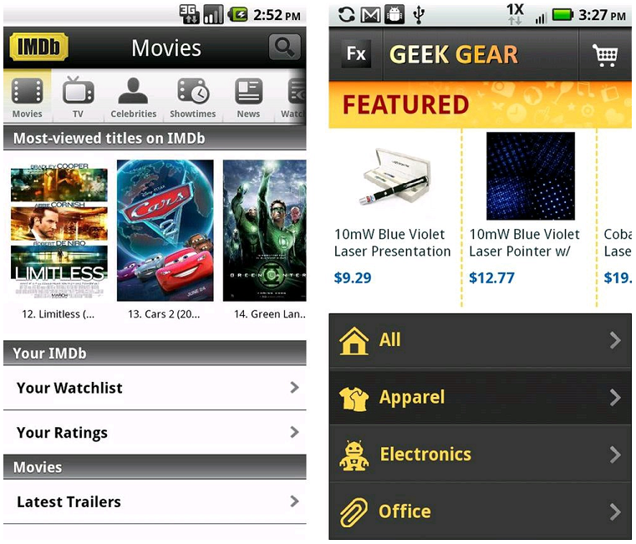
Image Carousel

Slide 23
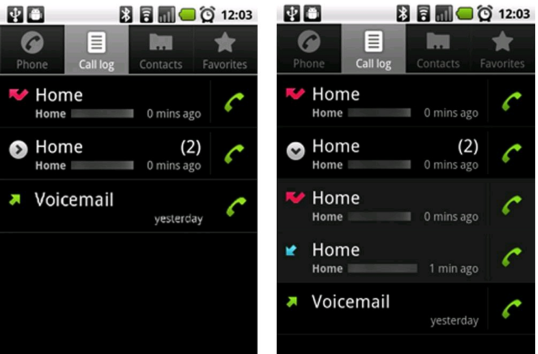
Expanding List

Slide 24
Forms
Sign In
Registration
Checkout
Calculate
Search Form
Multi-Step
Long Form

Slide 25
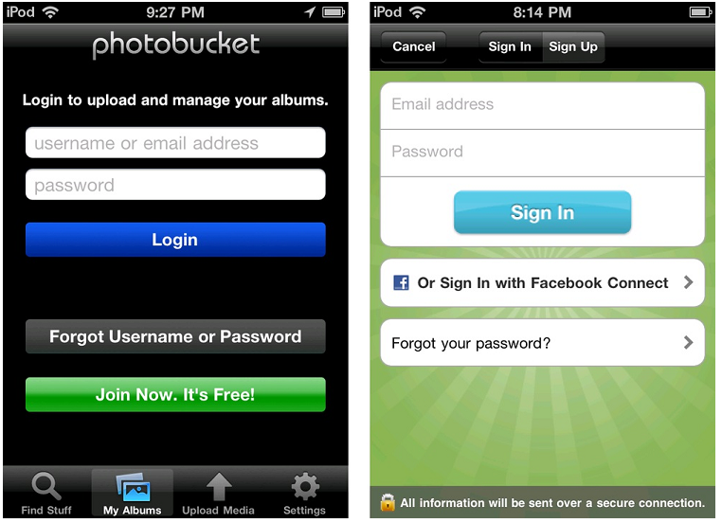
Sign In

Slide 26
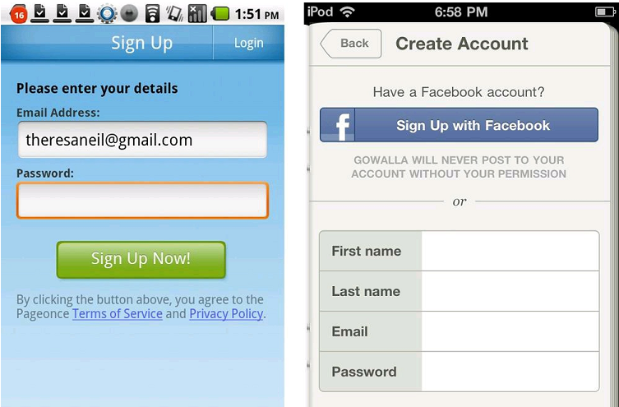
Registration

Slide 27
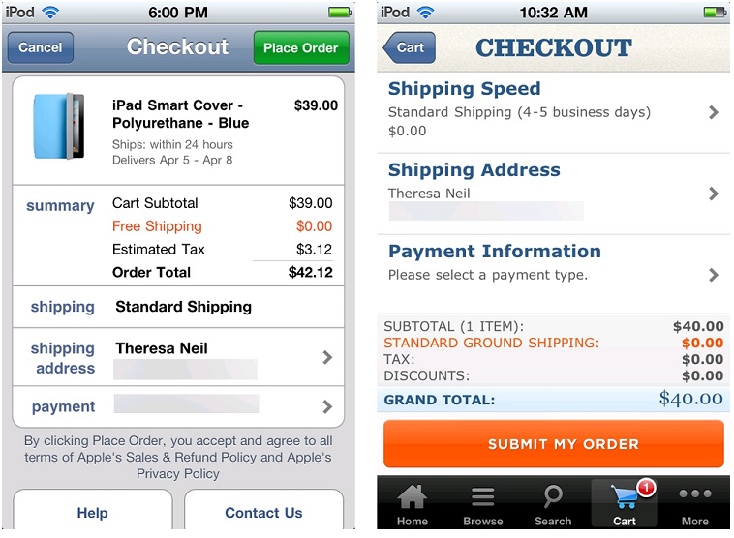
Checkout

Slide 28
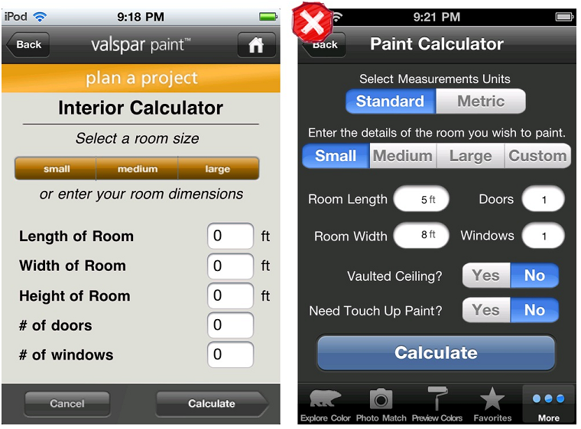
Calculate

Slide 29
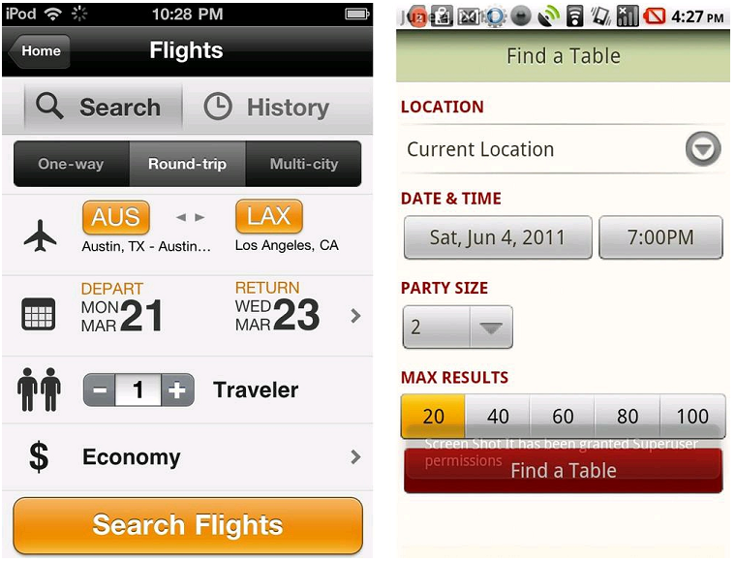
Search Form

Slide 30
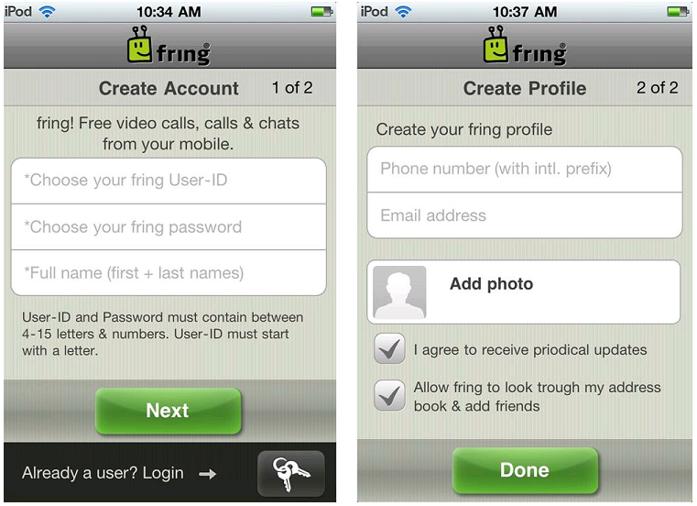
Multi-Step

Slide 31
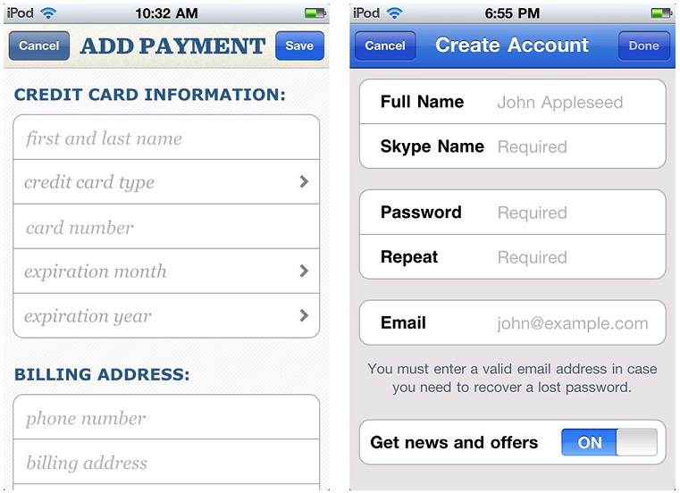
Long Form

Slide 32
Search
Explicit Search
Search with Auto-Complete
Dynamic Search
Scoped Search
Saved and Recent Searches
Search Form
Search Results/View Results

Slide 33
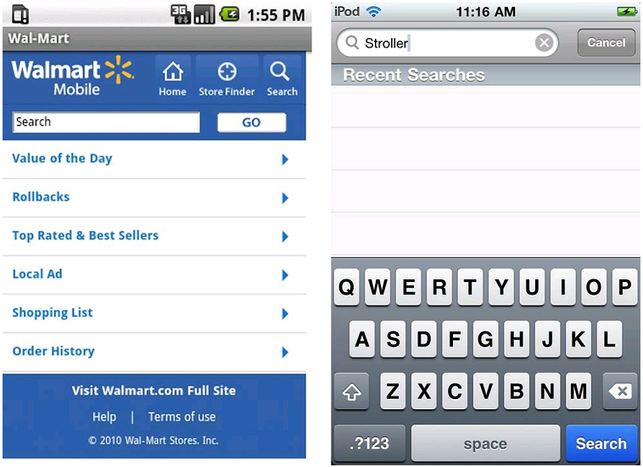
Explicit Search

Slide 34
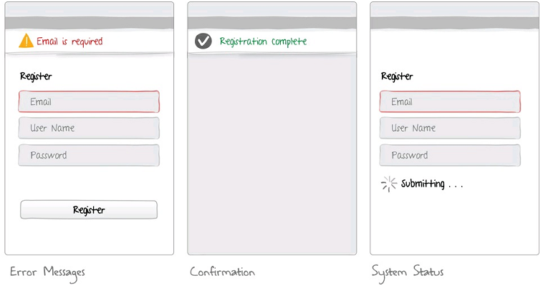
Feedback & Affordance

Slide 35
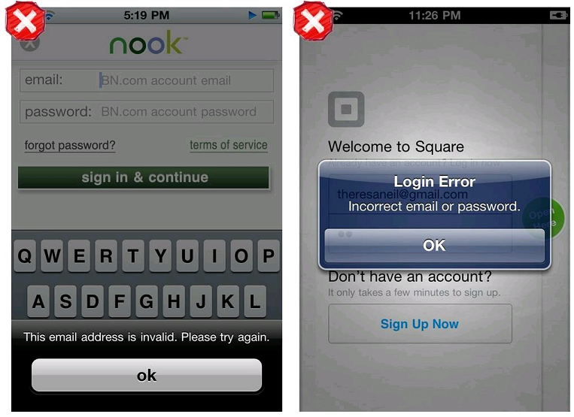
Error Messages

Slide 36
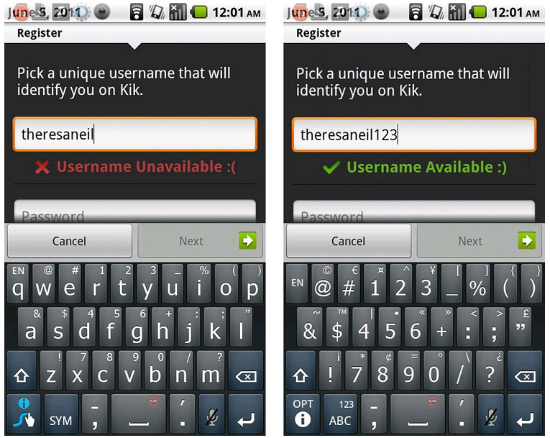
Confirmation

Slide 37
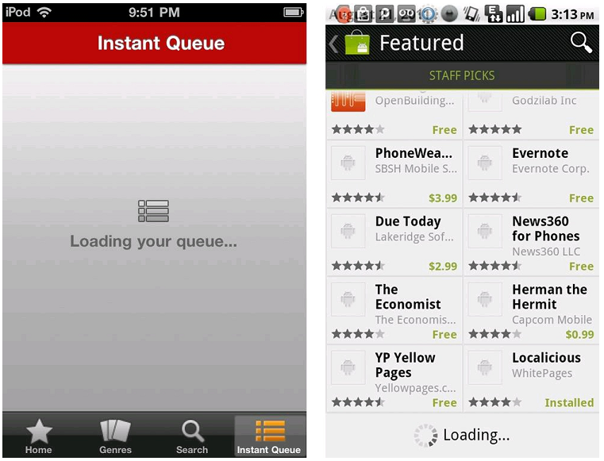
System Status

Slide 38
Web UI Patterns
Navigation
Forms
Search
Wizard

Slide 39
Web Navigation
Current popular homepage design: menus on top
Header: Logo, menu, sub-menu, search input box, login/out
Sliders: conveying the current most important messages
Content
Footer

Slide 40
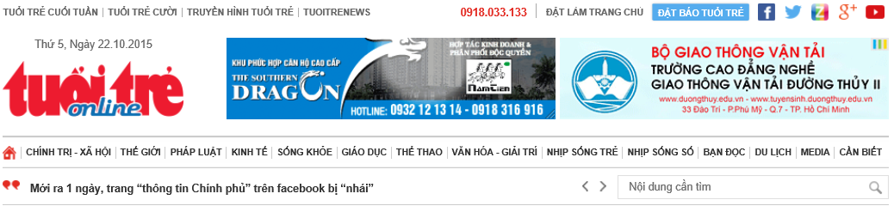

Header
Horizontal /Vertical primary menu and submenu
Sliders are most important messages, play but not too fast
Search input box on top should be prominent
Limit scroll on homepage
Always provide a Home link

Slide 41
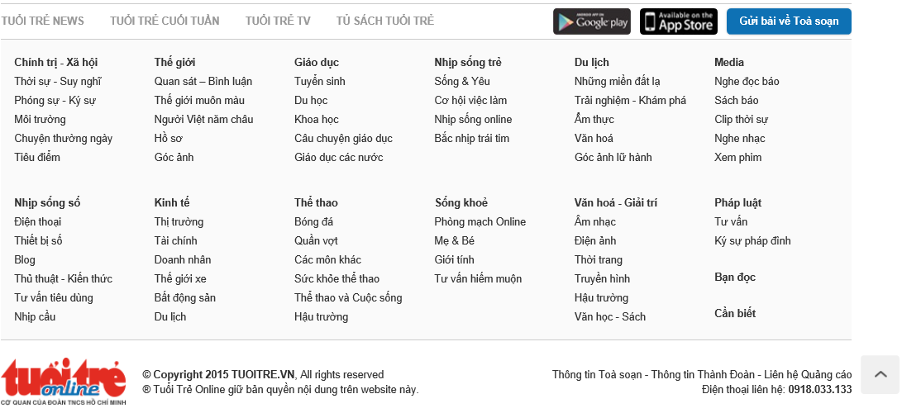
Footer
Secondary navigation to important information
Using the same footer for all pages
Links to frequently used pages

Slide 42
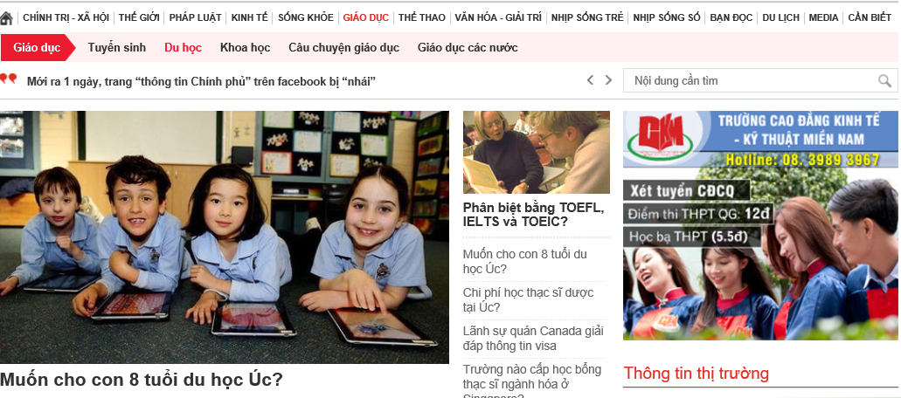
Breadcrumbs
Tell users where they have been, where they are, how they can go back

Slide 43



Pagination
Using Previous', 'Next', '<' and '>' icons, and page numbers

Slide 44
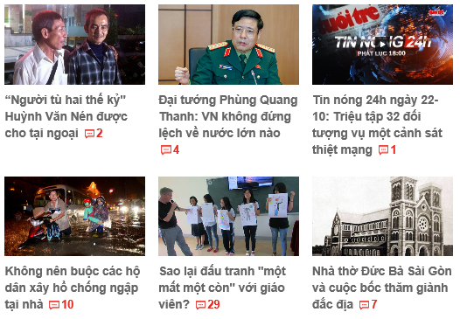
Carousel
Used to browse through a set of items
Used when there are many items and limited space while informing users of something more
Used for visual objects

Slide 45
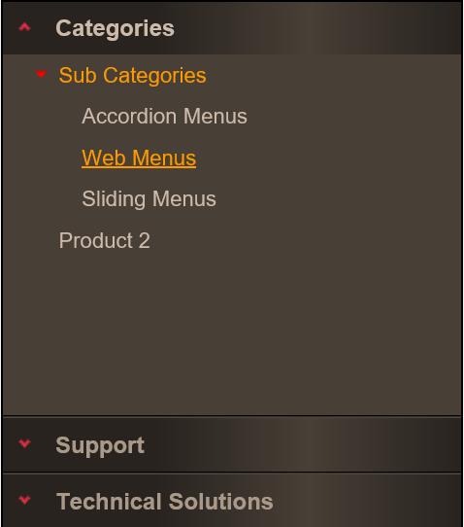
Accordion Menu
Very convenient for users to navigate through other items in the sub-menu
Allowing users to view content of a section while seeing other sections

Slide 46

Thumbnail Gallery
View many images without downloading full sized content
View on two mode current screen or popup

Slide 47
Form
Forms contain various input elements: text boxes, combo boxes (dropdown), radio buttons, etc.
Guidelines:
Use one-column left aligned forms
Mark required fields or active feedback on required fields
Provide good feedback for actions and good error messages
Place labels on the left or top and consistent throughout the website
Group related fields (using colors or shading)

Slide 48
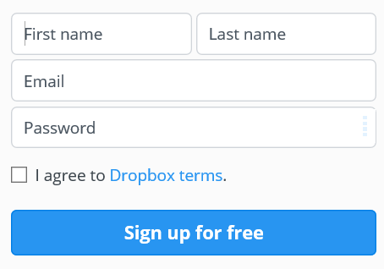
Form (Cont.)
Input prompts placed within input box
Good defaults
Good feedback
Few required info

Slide 49
Others
Password Strength Meter
Inplace Editor
Password Strength Meter
Input Validation
Lazy Registration
Search
Progress Indicator/Wizard

Slide 50
How to apply?
Sharing information about bootstrap
Try again and again
Self-design new pattern base on prototype
And practice more and more

